Slide 1
LoRa-Based Location Tracking and Fall Detection System
MCA491P : Major Project
1RV23MC080
RAJESHA C U
Under the Guidance
Of
Internal Guide
Dr. Deepika K
Associate Professor
Department of MCA
External Guide
Date : 15-5-2025 Department of MCA, RVCE

Slide 2
Agenda
Introduction
Literature Survey
Objectives of the Project Work
Proposed Methodology
Training Details
Work Progress
References
page:2/16

Slide 3
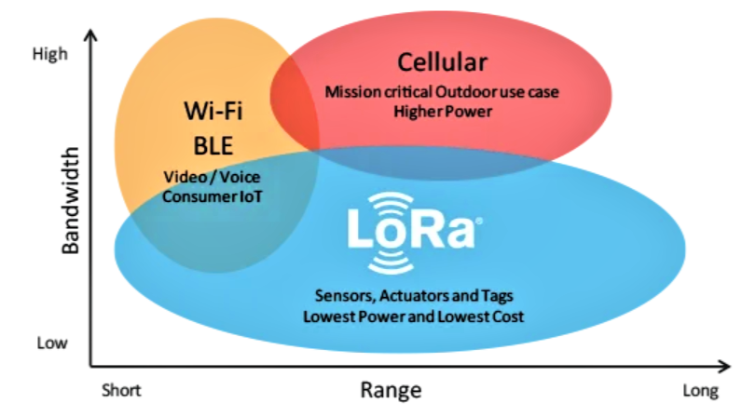
Introduction
Most remote trekking regions in India lack mobile,
Wi-Fi, or Bluetooth connectivity, leaving trekkers isolated during emergencies
Trekkers face life-threatening situations like injuries or getting lost, with no reliable means to call for help. A LoRa-based, low-power system enables real-time location approximation and fall detection without cellular or internet networks, keeping trekkers connected up to 15-20 km
page:4/16
page:3/16

Slide 4
Literature Survey
Sl No | Author (s) & Paper title | Details of Publication | Summary of the Paper
1 | Elma Zanaj, Deivis Disha, Susanna Spinsante, Ennio Gambi, “A Wearable Fall Detection System Based on LoRa LPWAN Technology” | Journal of Science; Technology , vol. 5, no. 3, pp. 160–165, May 2020 | Presents a fall detection system embedded in shoes that uses LoRa to transmit alerts without needing portable gateways, validated with reliable fall detection results.
2 | Mahnoor Anjum et al., “RSSI Fingerprinting-Based Localization Using Machine Learning in LoRa Networks” | arXiv preprint arXiv:2006.01278, June 2020 | Uses machine learning algorithms (SVM, decision trees) to improve localization accuracy via RSSI fingerprinting for LoRa-based systems.
3 | Ida Syafiza Binti Md Isa, Anis Hanani, “Development of Real-Time Indoor Human Tracking System Using LoRa Technology” | International Journal of Electrical and Computer Engineering, vol. 11, no. 2, 2021 | Develops a real-time indoor tracking system using RSSI-based positioning with LoRa to locate people in buildings.
page:4/16

Slide 5
Literature Survey
Sl No | Author (s) & Paper title | Details of Publication | Summary of the Paper
4 | Zeeshan Ali, Rida Zafar, Muhammad Tufail, “LoRa Based Location and Tracking System for Outdoor Applications” | International Journal of Advanced Computer Science and Applications (IJACSA), vol. 12, no. 3, Mar. 2021 | Implements a LoRa-based location tracking framework using triangulation and RSSI data to estimate mobile node positions in real-time outdoor environments.
5 | Yin Lin, Yuchen Li, Weizhe Zhang, “LoRa-based Trilateration Localization Using Adaptive Path Loss Model” | Sensors, MDPI, vol. 21, no. 12, Article 4080, Jun. 2021 | Proposes a trilateration approach using adaptive path loss models to improve the accuracy of LoRa-based location estimation in irregular terrains.
6 | K. V. Ravi Teja, R. Srinivasan, “Low Power LoRa Based Localization for IoT in Smart Agriculture” | CTACT Journal on Communication Technology, vol. 12, no. 4, Dec. 2021 | Presents a lightweight, energy-efficient LoRa localization solution for smart agriculture scenarios where network coverage is poor
page:5/16

Slide 6
Literature Survey
Sl No | Author (s) & Paper title | Details of Publication | Summary of the Paper
7 | Marwan Krunz, Bo Yu, “LoRa-Based Indoor Localization Using Machine Learning Techniques” | IEEE Internet of Things Journal, vol. 9, no. 6, Jun. 2022 | Explores machine learning models to enhance indoor localization performance using LoRa RSSI data, achieving higher accuracy than traditional methods.
8 | Ahmed M. A. Haidar, Hamed Al-Raweshidy, “Hybrid LoRa-Based Localization System Using RSSI and TDOA” | IEEE Systems Journal, vol. 17, no. 1, Mar. 2023 | Combines RSSI and Time Difference of Arrival (TDOA) for improved localization accuracy in LoRa networks, tested in a campus-wide deployment.
9 | Sweta Kedia, Rajendra G. Kavasseri, “LoRa-based Peer-to-Peer Tracking for Emergency Response in Remote Areas” | International Journal of Distributed Sensor Networks, vol. 18, no. 7, Jul. 2022 | Proposes a peer-to-peer LoRa system to track individuals in emergency scenarios like natural disasters and treks, relying entirely on offline communication.
10 | Fiumara, G., Siciliano, M., Frattini, G., et al. - Fall Detection Using Inertial Sensors: A Survey | Published in IEEE Transactions on Instrumentation and Measurement, 2021 | The paper surveys IMU-based fall detection systems, focusing on accelerometers, gyroscopes, and magnetometers.
page:6/16

Slide 7
Summary of the literature survey
Sl No | Author (s) & Paper title | Pros | Cons
1 | A Wearable Fall Detection System Based on LoRa LPWAN Technology | Demonstrates LoRa-based fall detection without gateways; validates wearable use. | Focuses on urban settings and shoe integration; lacks location tracking.
2 | RSSI Fingerprinting-Based Localization Using Machine Learning in LoRa Networks | Shows machine learning improves RSSI-based localization accuracy. | Requires fingerprinting and training data; less suitable for remote, unmapped areas.
3 | Development of Real-Time Indoor Human Tracking System Using LoRa Technology | Confirms real-time LoRa-based tracking is feasible. Uses real-time decision-making | Indoor-focused; RSSI behavior may not reflect complex outdoor terrains.
4 | LoRa Based Location and Tracking System for Outdoor Applications | Validates LoRa + RSSI triangulation for real-time outdoor tracking, directly applicable to your use case. | Accuracy depends heavily on node placement and terrain; may suffer in mountainous regions without dense coverage.
5 | LoRa-based Trilateration Localization Using Adaptive Path Loss Model | Uses adaptive path loss models to improve location accuracy in irregular terrains, aligning well with your mountain use case. | Increases computational complexity, which may not be suitable for low-power devices like ESP32.
page:7/16

Slide 8
Sl No | Author (s) & Paper title | Pros | Cons
6 | Low Power LoRa Based Localization for IoT in Smart Agriculture | Focuses on energy-efficient localization, supporting your low-power system goal; designed for sparse network areas. | Tailored for flat, open agricultural fields; may not perform well in obstructed, rugged environments.
7 | LoRa-Based Indoor Localization Using Machine Learning Techniques | Shows that machine learning enhances localization accuracy using RSSI, which can improve your positioning algorithm. | Focused on indoor environments; trained models may not generalize to outdoor or mountainous terrain.
8 | Hybrid LoRa-Based Localization System Using RSSI and TDOA | Combines RSSI and TDOA for higher accuracy, useful if you aim to improve localization precision. | TDOA requires time-synchronized nodes, which adds hardware complexity and power demands, not ideal for low-power wearables.
9 | LoRa-based Peer-to-Peer Tracking for Emergency Response in Remote Areas | Directly aligns with your project goal: peer-to-peer LoRa tracking for offline, remote-area emergencies; relevant design approach. | May have limited range and precision without dense node distribution or terrain-aware calibration.
10 | Fall Detection Using Inertial Sensors: A Survey | Provides a comprehensive overview of IMU-based fall detection, supporting your choice of accelerometer/gyroscope sensors. | Survey-based; does not propose or validate a specific system. No integration with LoRa or outdoor localization methods relevant to your application.
page:8/16

Slide 9
Objectives
Enhance trekker safety in remote, disconnected regions
Detect falls in real-time using onboard motion sensors
Enable offline communication through LoRa technology
Estimate location without using gps
Provide real-time alerts and emergency notifications
page:9/16

Slide 10
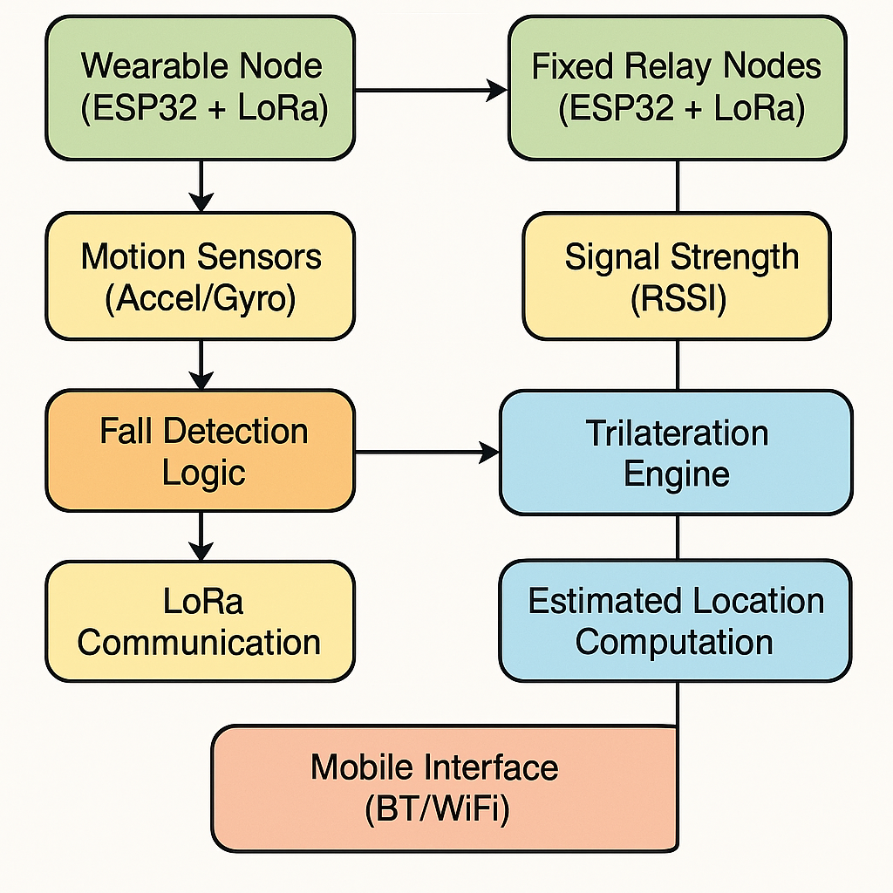
Proposed Methodology
Detect falls using onboard sensors.
Estimate location using LoRa RSSI-based triangulation.
Transmit data via LoRa to a central ESP32 receiver node.
Display real-time alerts and location estimates on a mobile device via a local Wi-Fi hotspot and web interface.
page:10/16

Slide 11
Proposed Methodology
Phase 1
Select optimal LoRa module ESP32 variant, and IMU .
Assemble ESP32 + LoRa + IMU on wearable
Build ESP32 + LoRa receiver with Wi-Fi for data relay.
Phase 2
Develop RSSI-based triangulation with multiple receivers.
Calibrate RSSI vs distance.
Phase 3
Serve a web dashboard from ESP32
Build responsive UI to show alerts, device status, and basic location data.
Phase 4
Conduct multi-node field testing and rescue simulations.
Fine-tune LoRa parameters: SF, Tx power, RSSI thresholds, fall sensitivity.
page:11/16

Slide 12
Tools/Techniques
ESP32 Microcontroller:
A low-power microcontroller used for processing data, controlling sensors, and handling communication with other devices in the system.
LoRa Technology (Long Range):
A wireless communication protocol used for long-range, low-power transmission of data between trekking devices, enabling connectivity in remote areas without relying on cellular or Wi-Fi networks.
Motion Sensors (Accelerometer & Gyroscope):
Sensors used to monitor movement and detect falls by capturing changes in orientation and acceleration.
RSSI-Based Trilateration:
A technique for estimating location based on the received signal strength from nearby LoRa nodes, enabling the system to determine a trekker's approximate position without GPS.
React Native & Next.js:
Frameworks used to develop a cross-platform mobile app and a web interface that together provide a user-friendly platform for displaying trekker data, monitoring movement, and sending or receiving emergency alerts in real time.
page:12/16

Slide 13
Training / Courses Undertaken
Next.js & React - The Complete Guide
A complete framework for building fast,a SEO-friendly React apps with built-in routing, SSR, and API support
IoT Sensors and Devices
Smart devices that collect and transmit data using sensors for real-time monitoring, automation, and control.
page:13/16

Slide 14
Plan for next phase review
System Architecture
Block diagram of the complete system (hardware + communication + software)
Hardware Implementation
Progress on assembling or prototyping the device.
Power management strategy for low-energy operation.
Suggestion and improvement discussed by the committee will be implemented in the next phase.
page:14/16

Slide 15
References
[1] Kumar, R., & Sharma, P. (2023). Safety solutions for trekkers in remote regions: A comprehensive study on the use of LoRa technology. International Journal of Adventure Tourism, 12(3), 101-112.
[2] Patil, S., & Deshmukh, A. (2022). Enhancing safety in off-grid environments: A review of communication technologies for remote trekking. Journal of Remote Sensing and Communications, 8(4), 200-215.
[3] Joshi, M., & Patel, R. (2021). The role of offline emergency systems in trekking: Addressing communication gaps in remote Indian landscapes. Journal of Wilderness Safety, 5(2), 58-68.
[4] Singh, S., & Thakur, V. (2020). The future of trekking safety: Evaluating the potential of IoT solutions in remote terrains. Journal of Outdoor and Wilderness Safety, 15(1), 45-54.
[5] Mehta, G., & Sharma, V. (2021). Real-time location tracking and fall detection systems for remote areas: A LoRa-based approach. Journal of Wireless Communications and Networking, 29(7), 12-23.
[6] Gupta, A., & Verma, A. (2019). Communication challenges and solutions for trekking in remote regions of India. Journal of Communications and Network Technologies, 10(3), 117-127.
[7] Chauhan, P., & Kaur, N. (2022). Disaster prevention and response for trekkers: The importance of offline communication systems in isolated regions. Journal of Disaster Management and Safety, 14(5), 225-234.
[8] Sharma, H., & Yadav, S. (2020). Enhancing trekking safety through wearable technology: A survey of fall detection and location tracking solutions. International Journal of Wearable Technologies, 7(2), 34-42.
[9] Desai, R., & Prakash, L. (2021). Low-power communication systems for trekking in remote regions: A case study of LoRa technology. Journal of Low-Power and Wide-Area Networks, 5(1), 75-88.
[10] Reddy, S., & Ramesh, S. (2019). IoT-based emergency response systems for trekkers in mountainous regions. Journal of Internet of Things and Emergency Services, 3(6), 144-156.
page:15/16

Slide 16
Thank you
page:16/16

